Slide 1
Secure Banking System using
Blockchain Technology
Capstone Project
Review -1
Team -25

Slide 2
Project Title : Secure Banking System using Blockchain Technology
Guide : Dr Nitish Andola
Members :
18BCY10034 | Fardeen Ahmed
18BCY10010 | Akshat Nigam
18BCY10093 | Shreyansh Saxena
18BCY10012 | Alkesh Gupta

Slide 3
Introduction
When payment systems were first computerized, the underlying processes were not significantly changed. While records and ledgers have been converted from paper to electronic form, the basic structure of centralized payment systems remained.
At the core of these conventional payment systems lies a central “clearing bank” serving as ledger, with settlement taking place across the books of this central authority.
(Contd.)

Slide 4
Introduction
Blockchain technology introduces a fundamentally different, decentralized structure into payment systems, with cryptography rather than a central clearing institution as its very basis, and without intermediaries such as banks.
While technology gives consumers new ways to spend money, sending money from one bank to another is still not a simple process. Blockchain can allow banks to let their users take advantage of the convenience provided by technology and the security provided by it.

Slide 5
Problem Statement
The Indian banking industry today is faced with issues such as rising costs of operations, increasing susceptibility to fraudulent attacks on centralized servers and challenges in ensuring transparency. All this, primarily because most of the banking transactions may require intensive manual processing and documentation, involve costly intermediaries and are time consuming as these transactions need to be validated by various participants at various point in time causing the delay thereby resulting in almost lack of fraud proof real time solution.

Slide 6
Literature Review
Blockchain application and outlook in the banking industry, Ye Guo and Chen Liang, 2016
In this paper Ye Guo and Chen Liang, had presented their idea by examining Chinese Banking sector. They said that Blockchains could revolutionize the underlying technology of the payment clearing and credit information systems in banks, thus upgrading and transforming them.
Blockchain Technology and the Financial Services Market, Krause et al., 2017
The technology could remove trusted third parties, decrease costs and ultimately increase profits for various players within the industry. Although public blockchain provide high data security and transparency, they are relatively slow if a high number of transactions needs to be processed. In the field of payment transactions, it could reshape the current correspondent banking processes and lead to cost savings.
(Contd.)

Slide 7
Literature Review
3. Block Chain & Financial Inclusion,Prof. Reena Aggrawal, 2017
A world bank report, 2014 said that around 2 billion individuals who don't have access to banking services. From which 20.6% unbanked individual are from India. This paper discussed that blockchain can play significant role in the financial Inclusion process. It says that F.I. using blockchain for internal and cross border payments can lower costs, shorten settlement time, and provide better user experience.
4. Blockchain in banking, Deloitte, 2017
As transaction are being done up on Blockchain, Blockchain DLT and all the relevant parties can view and verify the processes. There is only one source of truth and transactions cannot be processed further unless all the relevant parties agree and authenticate it.

Slide 8
Proposed Work
We aim to develop a web-based serverless application which works on a decentralized system for handling transactions between users ruling out the utilization of any centralized database.
All the transactions are to be verified by smart contract and stored in the Near Blockchain. The application will be built on the top of a cloud-based infrastructure which will be a community-operated cloud instead of a company-operated cloud.
Appropriate additional level of security measures will be implemented for the user authentication before any transactions occurs.

Slide 9
Real time usage
Blockchain has various real time usage such as :
Faster payments
Buying and selling assets
Fundraising
Credit and loans
Trade finance
Blockchain in banking as digital identity verification
Blockchain in banking for accounting and auditing

Slide 10
Software Requirements
Frameworks
React
Material UI
NEAR Blockchain
Languages
JavaScript
HTML & CSS
AssemblyScript
IDE
VS Code

Slide 11
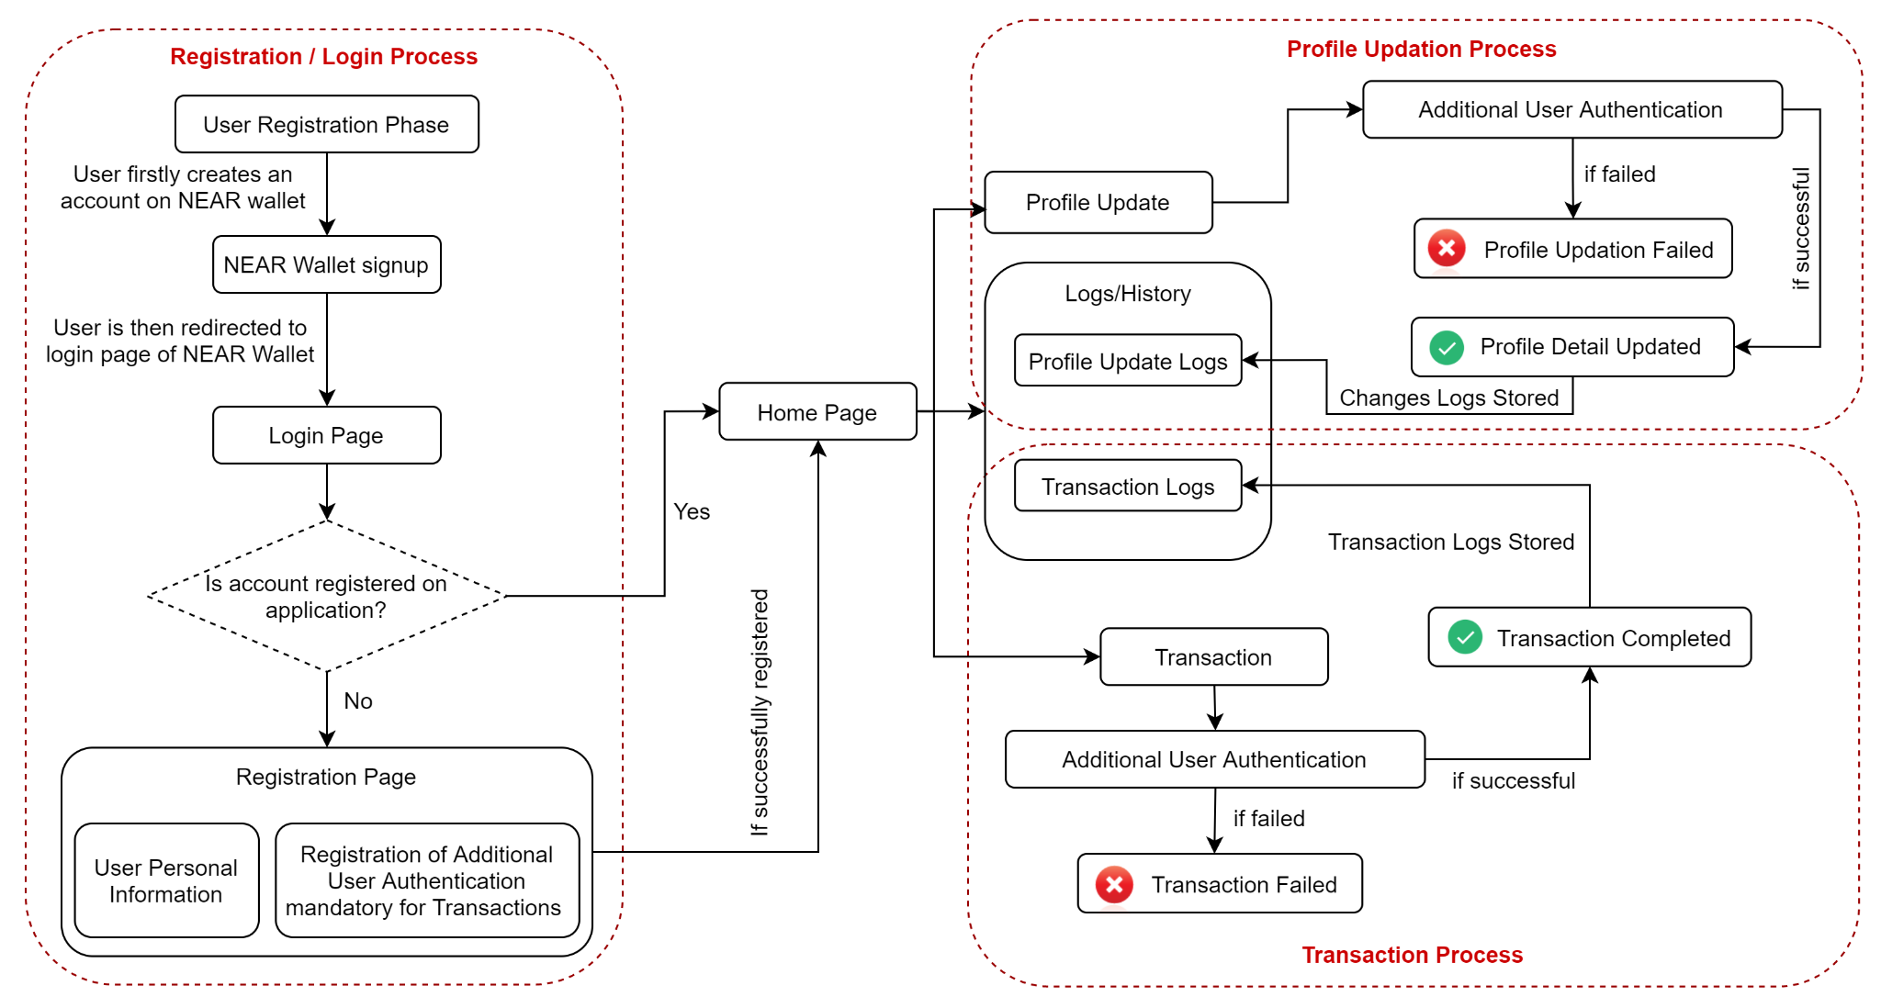
Overall System Architecture Diagram

Slide 12
Modules & Explanation
01. Authentication Module : User Registration & Login Process will be implemented under this module using NEAR wallet authentication.
02. Profile Details Module : Basic user details such as mobile, email, etc will be handled under this module.
03. Transaction Module : Money Transaction process between user accounts will be implemented.
04. Logs & History Module : Profile modification & transaction history will be managed under this module.
05. Additional Authentication Module : Second level authentication, for transaction purpose & profile updation, will be implemented in this module.

Slide 13
Project Timeline Chart
Sept. 21 - Oct. 21
Nov. 21 - Dec. 21
Jan. 22 - Feb. 22
March 22
Topic Selection, Idea Research & Planning
Implementation of Backend
Implementation of Frontend
Testing & Improvement
In this phase, we have decided our topic and planned the project based on the insights gained from the discussion over the information gained from various sources.
In this phase, we plan to develop our backend based on agile methodology with NEAR framework and AssemblyScript.
In this phase, we aim to develop the web-application frontend using HTML & CSS, ReactJS and Material UI.
In this phase, we plan to do improvisation to our application and will sort out any possible flaws.

Slide 14
THANK YOU

Slide 15
References
Blockchain application and outlook in the banking industry - Financial Innovation
Blockchain Technology and the Financial Services Market State-of-the-Art Analysis
Blockchain Technology –Revamping the Indian Financial sector landscape and roadblocks ahead
Blockchain in banking While the interest is huge, challenges remain for large scale adoption

